Slide 1
JSP and Database - Application

Slide 2
Agenda
JSP and some functions related to a system
How to forward a jsp page
How to insert a new data using JSP
How to modify existing data using JSP
How to delete data using JSP
How to search data using JSP

Slide 3
How can we make an integrated web system?
An integrated web system starts with a menu structure.
There are many ways to show the menu structure.
Next example shows a simple menu structure

Slide 4
Menu Structure
Login
Welcome
Error
Registration
User Lists
Update Menu
Delete Function
user_edit.jsp
update_reg.jsp
welcome.jsp
Role = admin
userlist.jsp
error.jsp
user_delete.jsp
registration.jsp
validate_reg.jsp
loginPage.jsp
xxx.jsp → A web page including scriptlet
xxx.jsp → A scriptlet

Slide 5
System Architecture
Request
loginPage.jsp
Login
Registration
validate_reg.jsp
Error handling
registration.jsp
Verification
error.jsp
customer
Browser
Welcome Page
welcome.jsp
Response
userlist.jsp
User’s List
Modification
user_edit.jsp
Deletion
update_reg.jsp
user_delete.jsp

Slide 6
Use Case Diagram
Register
Error
<<include>>
Login
Admin
User
Welcome
User List
User Edit
User Delete

Slide 7
Sequence Diagram
<<actor>>
User
registration
loginPage
validate
Error
Welcome
UserList
UserDelete
UserModify
Name, email,
Nationality,
User ID,
Password
Registration
Status
(user ID, password)
verifyLogin
(userID, password)
:true, session user
If role=admin
:false
Delete(userID)
Login error
Deletion result
Modify(userID)
Response to user
Modification result
Response to user

Slide 8
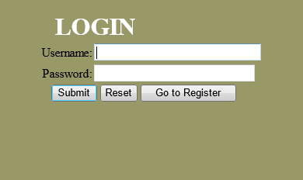
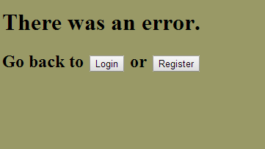
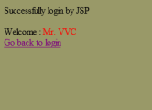
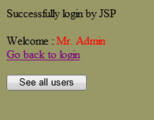
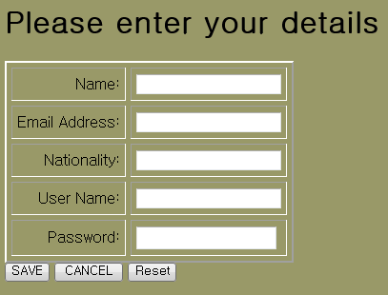
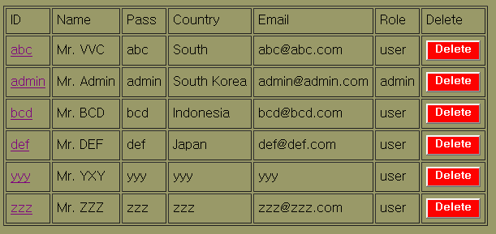
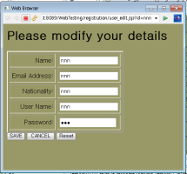
Menu Structure (add)
loginPage.jsp
Login Page
Error Page
error.jsp
welcome.jsp
Registration Page
Submission Page
welcome.jsp
registration.jsp
Admin Page
userlist.jsp
User List Page
validate_reg.jsp
User Edit Page (Popup Window)
user_edit.jsp
update_reg.jsp
user_delete.jsp

Slide 9
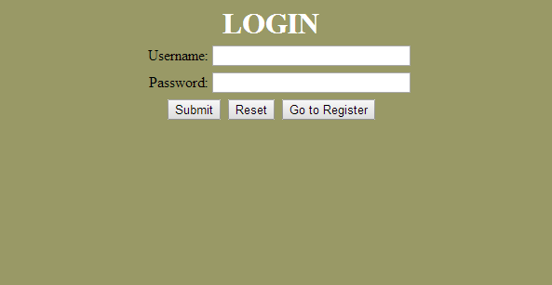
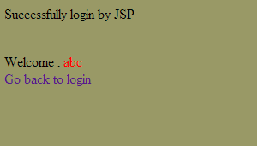
Practice
Login Page
error.jsp
loginPage.jsp
welcome.jsp

Slide 10
loginPage.jsp (1/3)
<%@ page language ="java" import="java.sql.*"%>
<html>
<head>
<title></title>
<meta http-equiv="Content-Type" content="text/html; charset=UTF-8">
<script>
function trim(s)
{
return s.replace( /^\s*/, "" ).replace( /\s*$/, "" );
}
function validate()
{
if(trim(document.form.sUserName.value)=="")
{
alert("Login empty");
document.form.sUserName.focus();
return false;
}
else if(trim(document.form.sPwd.value)=="")
{
alert("password empty");
document.form.sPwd.focus();
return false;
}
}
</script>

Slide 11
loginPage.jsp (2/3)
</head>
<body bgcolor="#999966">
<form name="form" action="" method="post" onsubmit="return validate();">
<table border="0" cellpadding="0" cellspacing="3" align="center" width="400">
<th colspan=2 width="270" align="center">
<font size=6 color="white">LOGIN</font>
</th>
<tr>
<td width="170" align="right">
Username:
</td>
<td width="290">
<input size="30" type="text" name="sUserName" id="sUserName">
</td>
</tr>
<tr>
<td width="170" align="right">
Password:
</td>
<td width="290">
<input size="30" type="password" name="sPwd" id="sPwd">
</td>
</tr>
<tr>
<td colspan="2" align="center">
<input type="submit" value="Submit">
<input type="reset" value="Reset">
<input type="button"
onclick="window.location.href='registration.jsp'" value="Go to Register">
</td>

Slide 12
loginPage.jsp (3/3)
</table>
<%
String user=request.getParameter("sUserName");
String pass=request.getParameter("sPwd");
String connectionURL = "jdbc:mysql://203.253.70.34:3306/isl";
try{
Class.forName("com.mysql.jdbc.Driver");
Connection con=DriverManager.getConnection(connectionURL, "user2016", "user2016!");
Statement st=con.createStatement();
ResultSet rs=st.executeQuery("select CustID, CustPass, Role from isl.customer where CustID='"+user+"' and CustPass='"+pass+"'");
int no = 0;
while(rs.next())
{
String username=rs.getString(1);
String password=rs.getString(2);
String role = rs.getString("Role");
if(user.equals(username) && pass.equals(password)){
session.setAttribute("username",user);
session.setAttribute("role",role);
%>
<jsp:forward page="welcome.jsp" />
<%
no = 1;
}
}
if(no==0)
{
response.sendRedirect("error.jsp");
}
}catch(Exception e1){}
%>
</form>
</body>
</html>

Slide 13
welcome.jsp
<%@ page contentType="text/html; charset=iso-8859-1" language="java"%>
<html>
<head>
<title>Successfully Login by JSP</title>
</head>
<body bgcolor="#999966">
Successfully login by JSP<br />
<br />
<%
String username=(String) session.getAttribute("username");
if(username==null) username="";
out.print("<p>Welcome : <span style='color:red'>"+username+"</span><br>");
out.print("<a href=\"loginPage.jsp\" >Go back to login</a>");
%>
</body>
</html>

Slide 14
error.jsp
<%@page contentType="text/html" pageEncoding="UTF-8"%>
<!DOCTYPE html>
<html>
<head>
<meta http-equiv="Content-Type" content="text/html; charset=UTF-8">
<title>JSP Page</title>
</head>
<body bgcolor="#999966">
<h1>There was an error.</h1>
<h2>Go back to <INPUT TYPE="BUTTON" VALUE="Login" ONCLICK="window.location.href='loginPage.jsp'">
or <INPUT TYPE="BUTTON" VALUE="Register" ONCLICK="window.location.href='registration.jsp'"></h2>
</body>
</html>

Slide 15
Insert a new data using JSP
registration.jsp
loginPage.jsp
validate_reg.jsp

Slide 16
registration.jsp (1/2)
<%@ page language="java" import="java.sql.*" contentType="text/html; charset=EUC-KR"
pageEncoding="EUC-KR"%>
<html>
<head>
<title>New User Registration</title>
<meta http-equiv="Content-Type" content="text/html; charset=iso-8859-1">
<script language="javascript">
function go_save()
{
var frm= document.formm;
if(frm.id.value =="")
{
alert("Input User ID");
frm.id.focus();
}
else if(frm.pw.value=="")
{
alert("Input password");
frm.pw.focus();
}
else if(confirm("Do you want to save?"))
{
frm.action="validate_reg.jsp";
frm.submit();
}
}
function go_cancel()
{
document.location.href("loginPage.jsp");
}
</script>
</head>

Slide 17
registration.jsp (2/2)
<body text="#000000" bgcolor="#999966">
<h1>Please enter your details</h1>
<form name="formm" method="post">
<table cellspacing="5" cellpadding="5" border="2">
<tr>
<td align="right">Name:</td>
<td><input type="text" name="name"></td>
</tr>
<tr>
<td align="right">Email Address:</td>
<td><input type="text" name="email"></td>
</tr>
<tr>
<td align="right">Nationality:</td>
<td><input type="text" name="nation"></td>
</tr>
<tr>
<td align="right">User Name:</td>
<td><input type="text" name="id"></td>
</tr>
<tr>
<td align="right">Password:</td>
<td><input type="password" name="pw"></td>
</tr>
</table>
<input type="button" value="SAVE" onclick="javascript:go_save();">
<input type="button" value="CANCEL" onclick="javascript:go_cancel()">
<input type="reset" value="Reset">
</form>
</body>
</html>

Slide 18
validate_reg.jsp
<%@ page language="java" import="java.sql.*, java.lang.*, java.util.*" contentType="text/html; charset=EUC-KR"
pageEncoding="EUC-KR"%>
<%
String name = request.getParameter("name");
String email = request.getParameter("email");
String nation = request.getParameter("nation");
String id = request.getParameter("id");
String pw = request.getParameter("pw");
String query_str = "insert into isl.customer (CustID, CustName, CustPass, CustCountry, CustEmail, Role ) values ('"+id+"','"+name+"', '"+pw+"','"+nation+"','"+email+"', 'user')";
int message = 0;
String connectionURL = "jdbc:mysql://203.253.70.34:3306/isl";
try{
Class.forName("com.mysql.jdbc.Driver");
Connection con=DriverManager.getConnection(connectionURL, "user2016", "user2016!");
Statement st=con.createStatement();
message = st.executeUpdate(query_str);
st.close();
con.close();
}
catch(Exception e1){}
if(message > 0)
{
response.sendRedirect("loginPage.jsp");
}
else
{
response.sendRedirect("error.jsp");
}
%>

Slide 19
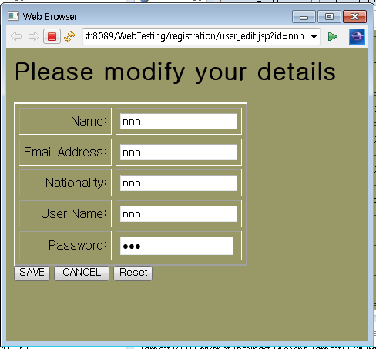
Modify & delete data using JSP
userlist.jsp
welcome.jsp (ver 2)
user_delete.jsp
user_edit.jsp
update_reg.jsp

Slide 20
welcome.jsp (ver. 2)
<%@ page contentType="text/html; charset=iso-8859-1" language="java"%>
<html>
<head>
<title>Successfully Login by JSP</title>
<script language="javascript">
function go_list()
{
var frm= document.formm;
frm.action="userlist.jsp";
frm.submit();
}
</script>
</head>
<body bgcolor="#999966">
Successfully login by JSP<br />
<br />
<%
String username=(String) session.getAttribute("username");
String role = (String) session.getAttribute("role");
System.out.println("role :"+role);
if(username==null) username="";
out.print("<p>Welcome : <span style='color:red'>"+username+"</span><br>");
out.print("<a href=\"loginPage.jsp\" >Go back to login</a>");
if(role.equalsIgnoreCase("admin"))
{
%>
<form name = "formm" method="post">
<input type="button" value="See all users" onclick="javascript:go_list();">
</form>
<%} else if (role.equalsIgnoreCase(null)) {role="";}%>
</body>
</html>

Slide 21
userlist.jsp (1/2)
<%@ page language="java" import="java.sql.*, java.lang.*, java.util.*" contentType="text/html; charset=EUC-KR"
pageEncoding="EUC-KR"%>
<!DOCTYPE html PUBLIC "-//W3C//DTD HTML 4.01 Transitional//EN" "http://www.w3.org/TR/html4/loose.dtd">
<html>
<head>
<script language="javascript">
function go_mod(id){
var url ="./user_edit.jsp?id="+id;
window.open(url, '_blank','menubar=no, resizable=no, toolbar=no, scrollbar=yes, status=no, width=420, height=420');
window.location.reload();
}
function go_del(id){
var f=document.formm;
f.method="post";
f.action='user_delete.jsp?id='+id;
f.submit();
window.location.reload();
}
</script>
<title>User List</title>
</head>
<body bgcolor="#999966">
<form name = "formm" method="post">
<table border="1" cellpadding=5>
<tr>
<td>ID</td>
<td>Name</td>
<td>Pass</td>
<td>Country</td>
<td>Email</td>
<td>Role</td>
<!-- <td>Edit</td> -->
<td>Delete</td>
</tr>

Slide 22
userlist.jsp (2/2)
<%
String connectionURL = "jdbc:mysql://203.253.70.34:3306/isl";
try{
Class.forName("com.mysql.jdbc.Driver");
Connection con=DriverManager.getConnection(connectionURL, "user2016", "user2016!");
Statement st=con.createStatement();
ResultSet rs=st.executeQuery("select * from isl.customer ");
while(rs.next())
{
%>
<tr>
<td> <a href="javascript:;" onClick="javascript:go_mod('<%=rs.getString(1) %>')" ><%=rs.getString("CustID") %></a></td>
<td><%=rs.getString("CustName") %></td>
<td><%=rs.getString("CustPass") %></td>
<td><%=rs.getString("CustCountry") %></td>
<td><%=rs.getString("CustEmail") %></td>
<td><%=rs.getString("Role") %></td>
<!--
<td><input type="button" name="edit" value="Edit" style="background-color:#49743D;font-weight:bold;color:#ffffff;" onClick="javascript:go_mod('<%=rs.getString(1)%>')" ></td> -->
<td> <input type="button" name="delete" value="Delete" style="background-color:#ff0000;font-weight:bold;color:#ffffff;" onClick="javascript:go_del('<%=rs.getString(1)%>')" ></td>
</tr>
<%
}
rs.close();
st.close();
con.close();
}
catch(Exception e1){}
%>
</form>
</table>
</body>
</html>

Slide 23
user_edit.jsp (1/3)
<%@ page language="java" import="java.sql.*, java.lang.*, java.util.*" contentType="text/html; charset=EUC-KR"
pageEncoding="EUC-KR"%>
<html>
<head>
<title>New User Registration</title>
<meta http-equiv="Content-Type" content="text/html; charset=iso-8859-1">
<script language="javascript">
function go_save(i)
{
var frm= document.formm;
if(frm.id.value =="")
{
alert("Input User ID");
frm.id.focus();
}
else if(frm.pw.value=="")
{
alert("Input password");
frm.pw.focus();
}
else if(i==0) {
if(confirm("Do you want to save?"))
{
frm.action="update_reg.jsp";
frm.submit();
window.opener.location.reload();
window.close();
}
}
else if(i==1)
{
window.opener.location.reload();
window.close();
}
}
</script>
</head>

Slide 24
user_edit.jsp (2/3)
<body text="#000000" bgcolor="#999966">
<h1>Please modify your details</h1>
<%
String id=request.getParameter("id");
String sql_select="select * from isl.customer where CustID='"+id+"'";
String connectionURL = "jdbc:mysql://203.253.70.34:3306/isl";
try {
Class.forName("com.mysql.jdbc.Driver");
Connection con=DriverManager.getConnection(connectionURL, "user2016", "user2016!");
Statement st = conn.createStatement();
ResultSet rs=st.executeQuery(sql_select);
String name=null;
String nation=null;
String email = null;
String pw = null;
while(rs.next())
{
name = rs.getString("CustName");
nation = rs.getString("CustCountry");
email = rs.getString("CustEmail");
pw = rs.getString("CustPass");
System.out.println(name);
}
%>

Slide 25
user_edit.jsp (3/3)
<form name="formm" method="post">
<table cellspacing="5" cellpadding="5" border="2">
<tr>
<td align="right">Name:</td>
<td><input type="text" name="name" value="<%=name %>"></td>
</tr>
<tr>
<td align="right">Email Address:</td>
<td><input type="text" name="email" value="<%=email%>"></td>
</tr>
<tr>
<td align="right">Nationality:</td>
<td><input type="text" name="nation" value="<%=nation%>"></td>
</tr>
<tr>
<td align="right">User Name:</td>
<td><input type="text" name="id" value="<%=id%>"></td>
</tr>
<tr>
<td align="right">Password:</td>
<td><input type="password" name="pw" value="<%=pw %>"></td>
</tr>
</table>
<input type="button" value="SAVE" onclick="javascript:go_save(0);">
<input type="button" value="CANCEL" onclick="javascript:go_save(1);">
<input type="reset" value="Reset">
</form>
<%
}
catch(Exception e){}
%>
</body>
</html>

Slide 26
update_reg.jsp
<%@ page language="java" import="java.sql.*, java.lang.*, java.util.*" contentType="text/html; charset=EUC-KR"
pageEncoding="EUC-KR"%>
<%
String name = request.getParameter("name");
String email = request.getParameter("email");
String nation = request.getParameter("nation");
String id = request.getParameter("id");
String pw = request.getParameter("pw");
String sql_update="update customer set CustID='"+id+"', CustName ='"+name+"', CustCountry='"+nation+"' ";
sql_update+=", CustEmail = '"+email+"' where CustID ='"+id+"' ";
int message = 0;
String connectionURL = "jdbc:mysql://203.253.70.34:3306/isl";
try{
Class.forName("com.mysql.jdbc.Driver");
Connection con=DriverManager.getConnection(connectionURL, "user2016", "user2016!");
Statement st=con.createStatement();
message = st.executeUpdate(sql_update);
st.close();
con.close();
}
catch(Exception e1){}
%>

Slide 27
user_delete.jsp
<%@ page language="java" import="java.sql.*, java.lang.*, java.util.*" contentType="text/html; charset=EUC-KR"
pageEncoding="EUC-KR"%>
<%
String id=request.getParameter("id");
String connectionURL = "jdbc:mysql://203.253.70.34:3306/isl";
try {
Class.forName("com.mysql.jdbc.Driver");
Connection conn=DriverManager.getConnection(connectionURL, "user2016", "user2016!");
Statement st = conn.createStatement();
st.executeUpdate("DELETE FROM isl.customer WHERE CustID = '"+id+"'");
response.sendRedirect("./userlist.jsp");
}
catch(Exception e){}
%>

Slide 28
Improve with search function
When the user’s name is getting large, it is hard to find a user name using scroll bar.
It is necessary to create a “search” function
Next example shows a way to search a particular character of a name in a DB

Slide 29
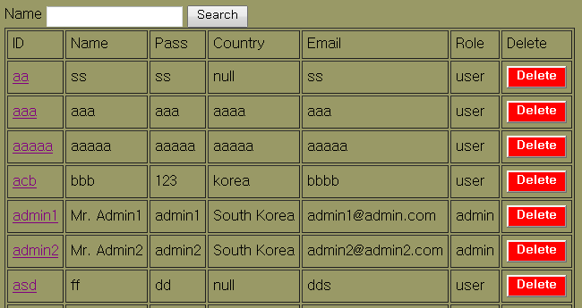
Searching function in the list page
userlist_s.jsp

Slide 30
userlist_s.jsp
<%@ page language="java" import="java.sql.*, java.lang.*, java.util.*" contentType="text/html; charset=EUC-KR"
pageEncoding="EUC-KR"%>
<!DOCTYPE html PUBLIC "-//W3C//DTD HTML 4.01 Transitional//EN" "http://www.w3.org/TR/html4/loose.dtd">
<html>
<head>
<script language="javascript">
function go_mod(id){
var url ="./user_edit.jsp?id="+id;
window.open(url, '_blank','menubar=no, resizable=no, toolbar=no, scrollbar=yes, status=no, width=420, height=420');
window.location.reload();
}
function go_del(id){
var f=document.formm;
f.method="post";
f.action='user_delete.jsp?id='+id;
f.submit();
window.location.reload();
}
function search_name(){
document.search.submit();
}
</script>
<title>User List</title>
</head>
<body bgcolor="#999966">
<form name = "search" method="post" action="userlist_s.jsp">
Name
<input type="text" name="searchname"></div>
<input type="button" name="search" value="Search" onclick="javascript:search_name()">
<%
String search = "";
search = request.getParameter("searchname");
%>
</form>
<form name = "formm" method="post">

Slide 31
userlist_s.jsp
<table border="1" cellpadding=5>
<tr>
<td>ID</td>
<td>Name</td>
<td>Pass</td>
<td>Country</td>
<td>Email</td>
<td>Role</td>
<!-- <td>Edit</td> -->
<td>Delete</td>
</tr>
<%
String connectionURL = "jdbc:mysql://203.253.70.34:3306/isl";
try{
Class.forName("com.mysql.jdbc.Driver");
Connection con=DriverManager.getConnection(connectionURL, "user2016", "user2016!");
Statement st=con.createStatement();
ResultSet rs=st.executeQuery("select * from isl.customer where CustName like '%"+search+"%'");//
while(rs.next())
{
%>
<tr>
<td> <a href="javascript:;" onClick="javascript:go_mod('<%=rs.getString(1) %>')" ><%=rs.getString("CustID") %></a></td>
<td><%=rs.getString("CustName") %></td>
<td><%=rs.getString("CustPass") %></td>
<td><%=rs.getString("CustCountry") %></td>
<td><%=rs.getString("CustEmail") %></td>
<td><%=rs.getString("Role") %></td>

Slide 32
userlist_s.jsp
<td> <input type="button" name="delete" value="Delete" style="background-color:#ff0000;font-weight:bold;color:#ffffff;" onClick="javascript:go_del('<%=rs.getString(1)%>')" ></td>
</tr>
<%
}
rs.close();
st.close();
con.close();
}
catch(Exception e1){}
%>
</form>
</table>
</body>
</html>

Slide 33
Summary
Forward a jsp page for scriptlet
Insert a new data using JSP (registration page)
Modify existing data using JSP (edit user data)
Delete data using JSP (delete user data)
Search data using JSP (search user data)

